Slide 1
Global Product Development
Thoughts and experiences about building software globally effectively
Hannu Kokko, 8 December, 2019

Slide 2








Did you know this about Elisa as a builder of unique digital services
96% of the customers who moved to our application service have ordered more services from us
1
+100
200
24/7
1 wk
1
contact point to lead a team built for you
Digital services in application service and development
developers at your service
Support
Fast start with one week sprint
All followup and monitoring from single point

Slide 3
Questions in the start
Agile
Kanban
Continuous integration
DevOps
Team / project sizes
Hannu Kokko

Slide 4
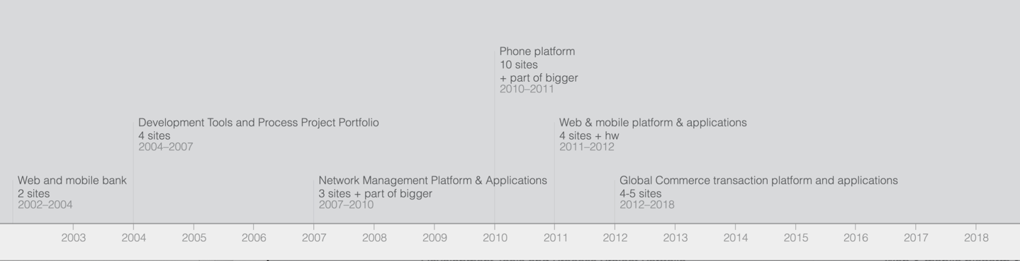
Distributed Product Development Fragments In My Story
Building, improving and leading distributed product development organisation in agile over long term is multifaceted challenge.
Ways of working together and emergence of common culture over geographical borders, leading the development and setting and following common goals are all important factors.
Over the journey agile, lean, team of teams, estimation practices, CI, common situational view and the usage of both technology and partners have developed and been elements of team success.
Hannu Kokko

Slide 5
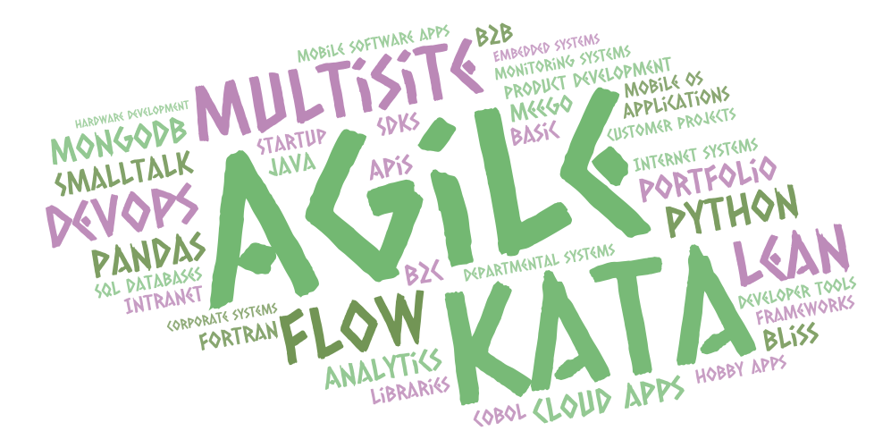
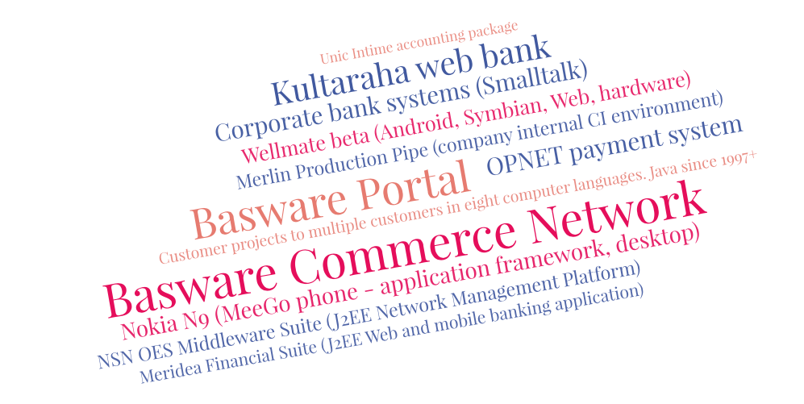
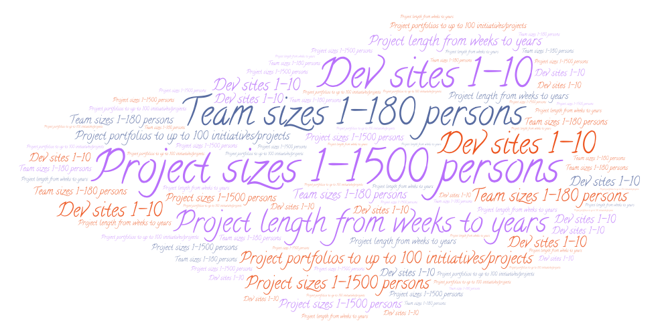
Stuff I’ve done since 1983
Hannu Kokko

Slide 6
What skills do you need in software and ICT nowadays and why? How can you gain them
Tech – changes rapidly
Full stack
Programming languages: Javascript, Python, Java, others
Mobile application development skills: iOS, Android
UX, AI, Data science
Mindset – more constant
Agile…
Willingness to constantly learn and experiment
Constant curiosity about new topics
Capability to work in self organized teams
Why: things change very quickly
More than one path
Apprenticeships
Summer trainees
Hobby projects
Open source
MooC
Universities
Reading widely
Networking
Mentoring

Slide 7
What do companies need, how do they get more skilled workers?
Software & ICT skills
Diversity in teams
Experience, short to have seen it all
Females, males, any other
Global, Local
How:
Grow - different doing paths. Think long term – rotate
Support and work together with learning institutions
Hire young – Hire existing talent – the balance

Slide 8
Diversity in teams
Diversity of all kinds in the teams helps build the solutions the diverse world deserves and needs.
Co-operation with university helps expand the diversity.
Female, Male, other
Fresher, Junior, Senior, Expert
Generations – youngster to have seen it all
Skill and industry domains
Cultural backgrounds
Global, local
Training backgrounds

Slide 9
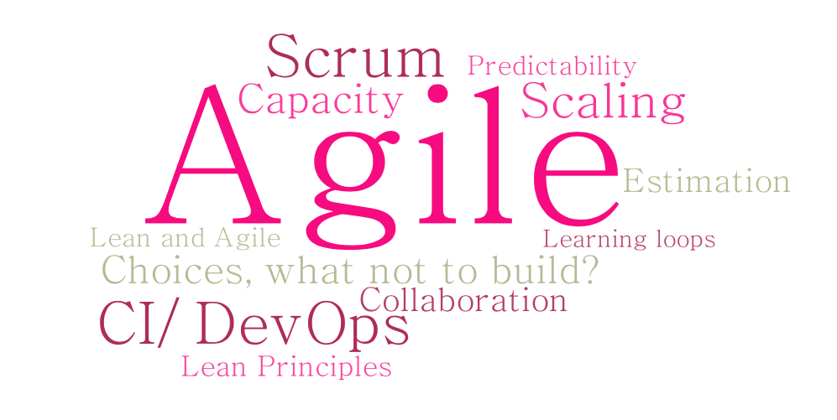
Aspects of building software globally effectively
Based on my experience across multiple companies - not a specific company – not any company view
Hannu Kokko

Slide 10
The most important thing: People
Hire well
Take good care of the people hired
Build for long term
Culture of learning
Culture of working together
Be an example
Involve teams in hiring
Hannu Kokko

Slide 11
Some things I have found useful…
Learn – ship – learn. Ship early.
Team of teams – flow, common situational view and common team targets, scaling and dependencies need attention and work constantly
Understand the customer
Everybody in the team needs to understand the problems AND the solutions.
Keep quality high constantly
Open eyes to the world
Always think of multiple different ways to build
Think about the future when building the present
Listen…
Hannu Kokko

Slide 12
Global Product Development Thoughts
Basics in place: Agile & ci
Technology aspects
Ways of working aspects
Scaling to multiple teams
Predictability and planning
Hannu Kokko

Slide 13
What are your company core competencies? What they should be?
Business domain skills
Digitalization of domain skills
Building
Integration
If digitalization is not my strength, how do I know what is good.
How do I know how quickly it can be done
Can I communicate this to digitalizers and builders
(Business Owner) 100%
Can I structure and phase product to builders (Product Owners (100%) and Architects (70-90%). Get a trusted, extremely competent, very long term partner
If building is not my strength – how do I know what is good.
How do I know how quickly it can be built.
Core knowledge / IPR.
Can I keep key persons the lifetime of the product (1-3-5-10 years). Lifetime cost
Can I scale with own people. Output? Cost? Stable load? Competence development?
In product dev (70%-90%), in projects can be less
Often use of integration technologies are fluctuating project by project and can be left to a partner.
Hannu Kokko

Slide 14
Agile Manifesto
Basics in Place
We are uncovering better ways of developing software by doing it and helping others do it. Through this work we have come to value:
Individuals and interactions over processes and tools Working software over comprehensive documentation Customer collaboration over contract negotiation Responding to change over following a plan
That is, while there is value in the items on the right, we value the items on the left more.
Hannu Kokko

Slide 15
Working practices
Basics in Place
Agile is useful in most cases
Scrum and Kanban when followed are pretty good ways of working
Short iterations are better than long ones. 1 week is ok for almost anything.
Build shippable user value not technical stories
Build good automated tests
Integrate several times a day. Ship that often if you can
Think about architecture and incurring technical debt
Do the simplest thing that can possibly work
Hannu Kokko

Slide 16
Agile: Nokia Test from 2007 is still a pretty good but basic canary
Basics in Place
First, are you doing Iterative Development?
Iterations must be timeboxed to less than 4 weeks
Software features must be tested and working at the end of each iteration
The Iteration must start before specification is complete
The next part of the test checks whether you are doing Scrum (in Nokia's opinion):
You know who the product owner is
There is a product backlog prioritized by business value
The product backlog has estimates created by the team
The team generates burndown charts and knows their velocity
There are no project managers (or anyone else) disrupting the work of the team
Add these at least:
Timebox is one (preferably) or two weeks
Are you doing retrospectives at end of each iteration + from the retro during next sprint. doing at least one item
Do all the developers check in their code at least once a day and integrate it in CI
Are you shipping to production at least once per iteration
Hannu Kokko

Slide 17
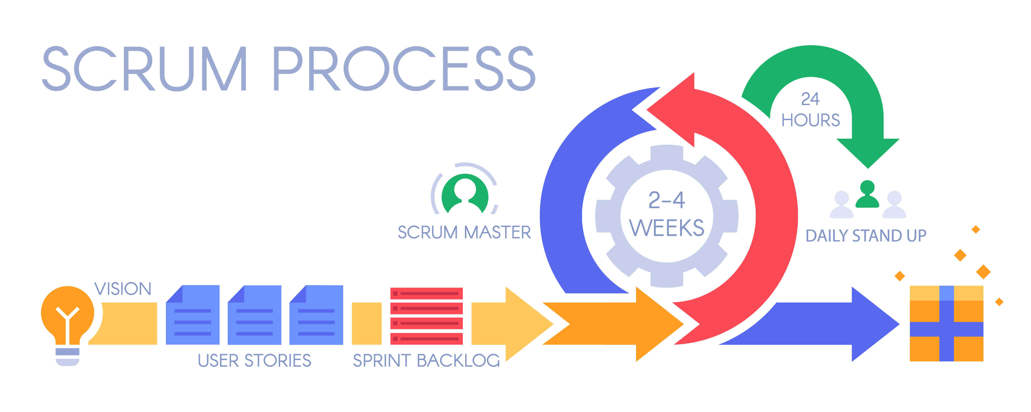
Scrum
Basics in Place
https://www.ntaskmanager.com/blog/newbies-guide-to-scrum-project-management-101/
Hannu Kokko

Slide 18
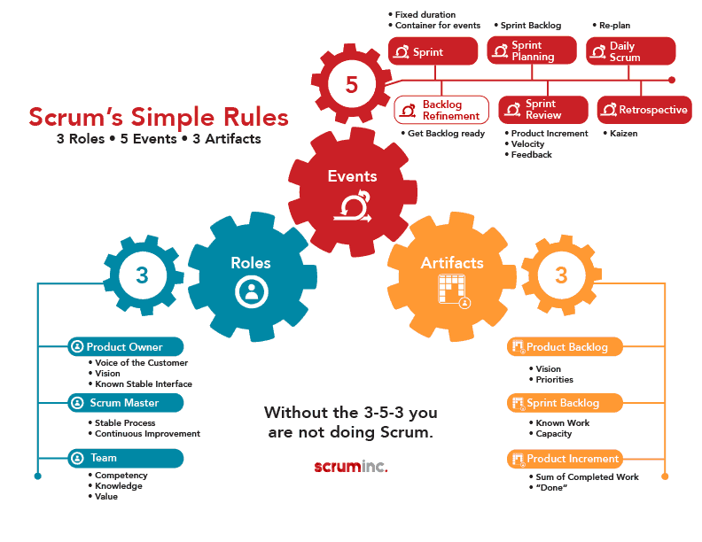
Scrum
Basics in Place
https://www.scruminc.com/the-3-5-3-of-scrum/
Hannu Kokko

Slide 19
Basics in Place

Slide 20
Basics in Place
Continuous Integration (CI) is a development practice that requires developers to integrate code into a shared repository several times a day. Each check-in is then verified by an automated build, allowing teams to detect problems early. By integrating regularly, you can detect errors quickly, and locate them more easily. (from ThoughtWorks)
DevOps is the practice of operations and development engineers participating together in the entire service lifecycle, from design through the development process to production support.
A primary corollary to this is that part of the major change in practice from previous methods is
DevOps is also characterized by operations staff making use many of the same techniques as developers for their systems work.”
From AgileAdmin blog
Single truth of the working software. Tests need to be good. Needs to be fast.
Hannu Kokko

Slide 21
Experiences from being PO for CI environments over 11 years
Basics in Place
CI environment should be developed in an agile way
Pure CI can work even in very large environment
Product owner is useful…
Faster feedback times can be achieved with performance engineering techniques
Faster feedback time and constant visibility brings more predictability and productivity to software development
Context is important
Bringing old codebases to CI – lot of work
Hannu Kokko

Slide 22
Era of the CI, CD and DevOps 2007-2018+
Basics in Place
Large code base
Product 1: "installed"
Extremely large code base – open source contribution & development – basically a Linux distro + applications
New development + hardware development
Embedded code C++
Many dozens of scrum teams. Multiple countries, multiple locations
Product 2: "embedded"
Compact code base. Hardware development
Refactoring in the large + applied research and new development
Java, JavaScript, C++, HTML5 – multiple phone OS, multiple browsers
9-10 scrum teams.
Multiple countries, multiple locations
Product 3: "web/mobile/hardware - cloud"
Product 4: SaaS / Cloud
Multiple old code bases and a new one.
Refactoring in the large, new development + maintenance
Java, Scala, JavaScript, HTML5. Mostly server code. Multiple databases (SQL, NoSQL). For all new development : startup stack
Between 10-20 scrum teams. Multiple countries, multiple locations
New development and refactoring. Maintenance
Mostly server code – Java & friends
Dozens of scrum teams. Multiple countries, multiple locations
Hannu Kokko

Slide 23
Faster feedback loops to learn faster Automate, Measure, make visible, optimize
Basics in Place
Learnings from Product 1-4
Parallelization by flexible use of development cloud
and QA cloud cost effective way of getting faster
Hannu Kokko

Slide 24
Use performance engineering to get faster – small change every sprint
Basics in Place
Learnings from Product 1 (“installed”)
Set goal
Instrument
Make visible
Monitor & feedback
Tune
Focused impact tuning
More memory and cpus
Parallelize builds
Replace 3rd party test libraries
Reduce/remove timeouts in tests
Select different tests
Refactor code & components
Tune the network & software
Tune the database
Wide impact tuning
Fast builds – less changes – more green Parallelization of test runs
Clearcase to subversion
Preinstalling as much as possible
Removal of randomness
Compilation in memory
Installation starting parallel with system build
Hannu Kokko

Slide 25
Process learnings for succeeding with large scale CI
Basics in Place
Learnings from Product 1-4
Overall
Active change agent/sponsor/owner needed
Continuous, persistent improvement – use agile
invest in local coaching during deployment
Actionable radiators everywhere.
Integrate the visibility. History is useful
Have dedicated team but do not separate it to different organisation. Super close co-op is the key.
Eliminate with hard hand all excuses for not automating
Anything can be made much faster
Keep builds & tests fast
Do not hide long in branches.
Feature flags are useful (product 4)
For developers and program
Small batch sizes – fast feedback -> increased productivity
Unlikely to prove at component level that integration will work
Mindset change – grow the code.
Do not hide in branches: Commit constantly – every day.
Program rules – “fix the build”
Hannu Kokko

Slide 26
Lean principles – speed
Basics in Place
Learnings from Product 1-4
Constantly question the necessity of steps, length of steps, parallelization and serialization of steps in the overall (#CI) system
Make it a habit of being a bit faster every day. Refactor in the small, in the large. Computer should wait, not human. #CI
Almost anything can be made faster. Most often by 70%+ faster
Hannu Kokko

Slide 27
Lean principles – inventory
Basics in Place
Learnings from Product 1-4
For CI to work in large environment lean thinking must be applied. Minimize the batch size. Remove waits and minimize work in progress
Watch your commit & integration rhythm and keep it reasonable or know the good reasons why especially when working with multiple teams.
Long interval between committing changes can mean you are building your software in too big chunks.
Large user stories, or refactorings. Too many unintegrated changes in your inventory might lead to integration problems especially with multiple teams.
If your team members are not committing their changes in logical chunks (almost) every day you might have too much inventory building
Hannu Kokko

Slide 28
Visibility in continuous integration
Basics in Place
Learnings from Product 1-4
CI system is a treasure trove of information
Give just enough information on radiators. Make it understandable by anyone. Less is much more
Make the information in radiators/histories understandable by anyone in project
Mining the continuous integration database:
history - are builds breaking often during the sprint or two
are builds being done?
is software robust, same tests with no changes same results
are the tests finding the right problems - talk to people, compare tests
are the tests getting slower, do the tests break often – where
do components / teams add tests over time, do they fix tests quickly
Hannu Kokko

Slide 29
Summary of the age of CI
Basics in Place
Learnings from Product 1-4
In larger projects a separate team may focus tooling development. Persistent commitment is needed.
Have active sponsor/PO
CI works even in large projects.
Sprint by sprint improvements – not big bang
Good tests are important
Context is important.
Performance engineering will speed up the feedback – all teams need to participate.
Faster feedback time & visibility increases productivity
Hannu Kokko

Slide 30
Traditional wastes of development
Ways of working - Lean
Extra Features
Relearning
Handoffs
Delays
Task Switching
Defects
Partially done work
Biggest waste:
Building the wrong thing.
Efficiency view
Addressed by Agile
Effectiveness view
Addressed by principles of Lean Startup
Hannu Kokko

Slide 31
Lean Startup - Effectiveness
Ways of working - Lean
Learning loops
New Business Hypothesis with Measures
Prove Hypothesis in Production by Measures
Build MVP with built in measures
Continuous Delivery / DevOps
In R&D
One week sprints
In Production
- Intra-day - One week – one month deliveries
Product
Think output metrics
Learning
Delay
Speed
Example: Pirate metrics
Acquisition
Activation
Retention
Referrals
Revenue
Visibility & Automation
Productive
Incremental Target Architecture
CI/ Continuous Delivery / DevOps
Build MVP with built in measures
Decrease time from hypothesis to proven business feature
Lean
Way of Working
Hannu Kokko

Slide 32
Lean principles in agile – Efficiency
Ways of working - Lean
Learning loops
Reduce Unimplemented backlog items
Reduce Bugs
Untested code
Code changes not in production
Compiled but not tested code
Improve Feedback time for
User story invention to production
running component functional tests
running system functional tests
running system performance tests
Compile time
Installation time to
Production environment
Eliminate Waste
Missing testing -> unnecessary repeat loops
Remove duplicated (repeated) work
Reduce/remove interim products not used afterwards
Reduce Inventory & WIP
WIP Limit
Remove unnecessary steps
Automate manual tests
Automate repeated manual steps (build, deployment)
Size of stories
Eliminate feature flags when their time has gone
Commit to
running the unit tests
Test environment
Test time
Unvalidated features
Epics/ Features / stories in progress
Reduce age of bugs, code changes not in production
Maximize learning opportunities by having fast feedback loop
Prioritize biggest improvement potential that is solvable soonest.
Faster every sprint
Hannu Kokko

Slide 33
Principles of scaling Agile (from Less)
Scaling to multiple teams
Effectiveness or efficiency?
Visibility – Act on It
MVP – MDP?
Fluent flow
Minimize
inventory
Lean Startup
“Get out of the
Building”
Continuously Faster Feedback Loop – Increase Speed of Learning
Hannu Kokko

Slide 34









Self organized team of teams differ from other forms of teams in several distinct ways
Scaling to multiple teams
Rapid response with all the contextual information close to customer. ​
Alignment between teams concrete and rapid. Objectives built up from both directions​
E2E Team
Customer need is a starting point
Customer-centricity
Network of teams
Company
Decisions about how to respond in the customer facing team much more often
Management communicates clearly the purpose and direction
Transparent operative information available to all in team of teams​

Slide 35
Scaling to multiple teams
Information and work needs to flow easy and fast.
Agree on enough common things
Single team (ideal)
BO, PO, Scrum team (end to end)
same coffee machine
same (open) space
high frequency, high bandwidth communication
Common Ways of working
Common – Concrete – Goals
Common situational view (radiators)
Definition of done
Demo
CI/CD/DevOPS
-> Fast common builds, test & ops automation…
Dependency handling…
Team chat, devgrooming, cross team ’gate’ meetings
APIs, “Micro”services, Static analyzers
Short distance, few teams
Kanban in the walls, system drawn in the walls, whiteboards, flipcharts
Flowdock / Slack / MS Teams chat, Radiators
Long distance and/or many teams
Shared easy tools
Flowdock / Slack / MS Teams, Radiators
Confluence, Jira boards, Gliffy
Hannu Kokko

Slide 36
Scale by enabling the teams
Scaling to multiple teams
Aim for E2E self organised teams
No ”helper” / functional teams (eg ”testing”)
Grow all the teams to be first class citizens on their domain and eventually overall
Build and grow the structure of the team for the long term – consultants as specialty experts, advisors or work force – core or context?
Only team of teams goals
for example: ways of working goals or
concrete enough OKRs instead of individual goals
Horizontal real time communications
Minimize dependencies in tech and functions
Common easy access to all the product artifacts and situational view
Goal dimensions
Speed (automation)
Predictability of throughput
Quality Debt
Visibility
Example: Ways of working goals
Hannu Kokko

Slide 37
Scale by improving ways of working
Scaling to multiple teams
Don’t leave too much debt behind
Low number of bugs, or get bitten at bad time
1 bug per 3 developers open.
No old bugs
Update the libraries – Whitesource or similar
Rapid iteration loops, constant delivery.
Keep eye on the flow, small WIP
CI, CD, DevOps do not call it ci if you just build stuff
Minimize delivery chunks
Coverage is safety net
Automate…
Make everything visible and actionable
Horizontal real time communications
Involve regularly the cross team knowledge on common technical and functional teams
- Devgrooming, ”gates” discussion
Hannu Kokko

Slide 38
Challenges in scaling
Scaling to multiple teams
Large timezone differences
Siloes or silo objectives slowing down the flow
Product dependencies : Functional, technical, external dependencies
People dependencies: role, responsibilities, skillset (”Pete the Bottleneck”, ”HQ”)
Cultural issues (team culture (”not willing to participate”, NIH, people culture)
Large ”legacy” codebases
Common ”design” activities across sites
Maintaining the retrospective culture
Hannu Kokko

Slide 39
World full of choices - opportunity or threat?
Technology aspects
Windows vs Linux
Amazon vs Azure vs Google Cloud vs local clouds vs IT vendor clouds vs hosting vs…
JavaScript vs Python vs Java vs Scala vs C# vs PHP vs RubyOnRails
React vs Flutter vs AngularJS vs Knockout vs Ember vs…
Spring vs J2EE
Relational databases vs NoSQL
MongoDb vs other NoSQL databases
EnterpriseBus vs ordinary queues
Commercial or open source
etc
Native mobile code vs React vs HTML5 vs generators
…and this is only the technology stack part.
Hannu Kokko

Slide 40
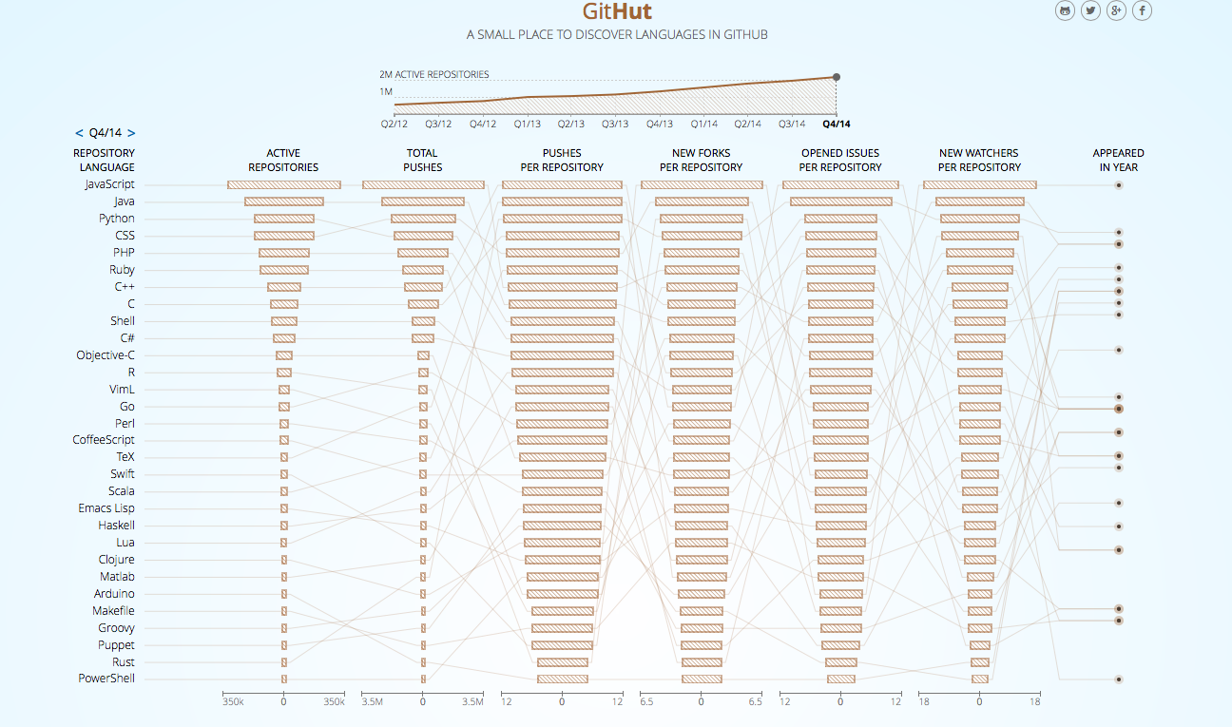
World full of choices - opportunity or threat?
Technology aspects
300.000+ JavaScript Repositories
200.000+ Java Repositories
based on 2014 data
Hannu Kokko

Slide 41
Technology aspects
“Don’t do your own
undifferentiated heavy lifting”
-Netflix
Don’t invent integration
use Enterprise Integration Patterns
http://www.enterpriseintegrationpatterns.com
Hannu Kokko

Slide 42
Do not build without a really good reason…
Technology aspects
Queue (for example to a database)
Workflow – engine
Enterprise Integration Bus solution
Full Javascript UI framework
Own tx solution on top of NoSQL
Reporting engine
Persistence framework
Rules engine
Deployment framework
…and there are other utility / framework categories…
Hannu Kokko

Slide 43
Consider with care do you really want to
Technology aspects
Use commercial framework
Build your own framework
Take into use
consultant company’s own framework
large open source FRAMEWORK
a new framework that does similar thing than an existing one
a second cloud
another database
ENTERPRISE version of anything
Take into use
opensource library that is rare
a generator
commercial test framework
framework with no upgrade path
NoSQL database for product that needs lots of adhoc reporting
Have libraries, products, tools that are older than 1-2 years
Form “sufficient enough” approval method for components and frameworks to be taken into use.
Approve beforehand.
Follow ThoughtWorks Tech Radar
Hannu Kokko

Slide 44
Think about lifetime of your system (applications and application portfolio)
Technology aspects
Ensure understanding of the solution in house from architects to production
Is your tech solution unique one – Why? Really – Why? Why…
Ensure availability of skills from several vendors / market
Right amount of moving parts. For each purpose approximately one solution, at most two.
Beware “Flavor of the day”, Cool tech to consultant CV or real competitive advantage (productivity, time to market)
Security – more you have components, more you need to update
Think about skill needs, maintenance and support of your moving parts…
Scalability: what means – plus 50% plus 100% plus 1000% increase to estimated usage
Machines, memory, cpu, disks, licenses
Hannu Kokko

Slide 45
Predictability - Ways to keep your promises
Predictability & Planning
Keep sprints short
One week. Can be done to at least 100+ team size
Definition of done – crisp and followed.
Keep stories small – many per sprint.
3+ per team per sprint at minimum. -> you will be able to deliver at least two of them…
”testing”, ”technical task”, ”refactoring” etc is not user story
Do not play submarine – very very few big epics or stories.
Demo business level understandable stories once per week to your stakeholders
Honor your WIP limits
Get to the rhythm: Long term weekly average of promised vs delivered user stories 70% is a good number
Keep bug count low and keep bugs young – less surprises and slowdowns
Automate as you go
Relentlessly. You will not have time later.
Deliver often.
Once a week – at least. Best in Finland are doing 5-10-20 a day – even in large teams
Hannu Kokko

Slide 46
When you have to estimate: Capacity side
Predictability & Planning
Establish your predictability (teams delivering 70%+ of the committed user stories per sprint). Most stories should be sprint sized
Constant delivery -> no testing ”phase”.
Capacity = How many user stories teams overall are capable of delivering per month / sprint over time.
Use the sum of teams more than individual teams number.
Monitor the numbers and do learning loop until it stabilizes.
Use the team level number to advise you when splitting the work to teams…
All the work included, not just developing the stories
Velocity must NEVER be incentivized KPI
Do not compare teams velocity numbers
No need to standardize user story size
Hannu Kokko

Slide 47
When you have to estimate: Demand side
Predictability & Planning
Those who know estimate roughly the number of stories and what they roughly (groups or names of stories) would be on whiteboard etc.
Split to reasonably sized Epics that can be delivered separately – MVP…
Record the estimated stories for the epic/s.
Expansion factor
Monitor # of stories teams actually created in implementation = implementation stories
Sum of implementation stories / sum of estimated user stories (in a year or half a year) = expansion factor
Update the expansion factor as more stories gets built (every quarter / half a year)
Demand = Number of estimated user stories x expansion factor
Is the Epic’s number of estimation user stories x expansion factor reasonable for the business case. (as a fraction of capacity)
Roughly how/where does the Epic fit to available capacity…
Keep your epics small to deliver them early and to keep WIP low.
Ideally deliver every sprint or more often to production
Team / sprint level estimation techniques are up to the teams – use any/many
Hannu Kokko

Slide 48
Possible portfolio views
Predictability & Planning
Business views (Innovation accounting, sales/costs) #money
Capability view
Understand your capacity to deliver by quarter/month #user stories
What kinds of work the teams are doing # user stories
Architectural foundation
Refactoring in the large
Customer specific
Strategic initiative 1
Strategic initiative 2…
Codebase capability view
Which teams are changing what components
Knowledge, bottlenecks
Hannu Kokko

Slide 49
Last words
Prove business value quickly - fresh food business
Fast to production (weekly, daily or faster) – fast feedback & learning cycle – Lean startup/Agile/Kanban
Common, interlocked goals to all the teams
Cost is only one parameter – too easily measured. Measure output, flow and effectiveness
Long term commitment and support for improvement = leadership, management and culture
Small change every day – many sprints of steady improvement can whittle down the largest issues
Less Technical and Quality Debt = more flexibility
Ways of working goals will make the teams better over time
Ensure skillset availability at your locations
Do not build what you can get from open source or commercial
“Optimize” project portfolio over time not single project
Hannu Kokko

Slide 50
Thank You !

